Slide 1


The Global Burden of Diabetes
Dr. Naeem Zahid
MD, PhD, MBA

Slide 2
What is diabetes?
Diabetes type 1
Insulin is not produced
Diabetes type 2
Enough Insulin is not produced
Insulin is not processed
Gestational diabetes
Insulin is not as effective during pregnancy

Slide 3
592 million people with diabetes in 2035
55 %
382 million people with diabetes in 2013

Slide 4
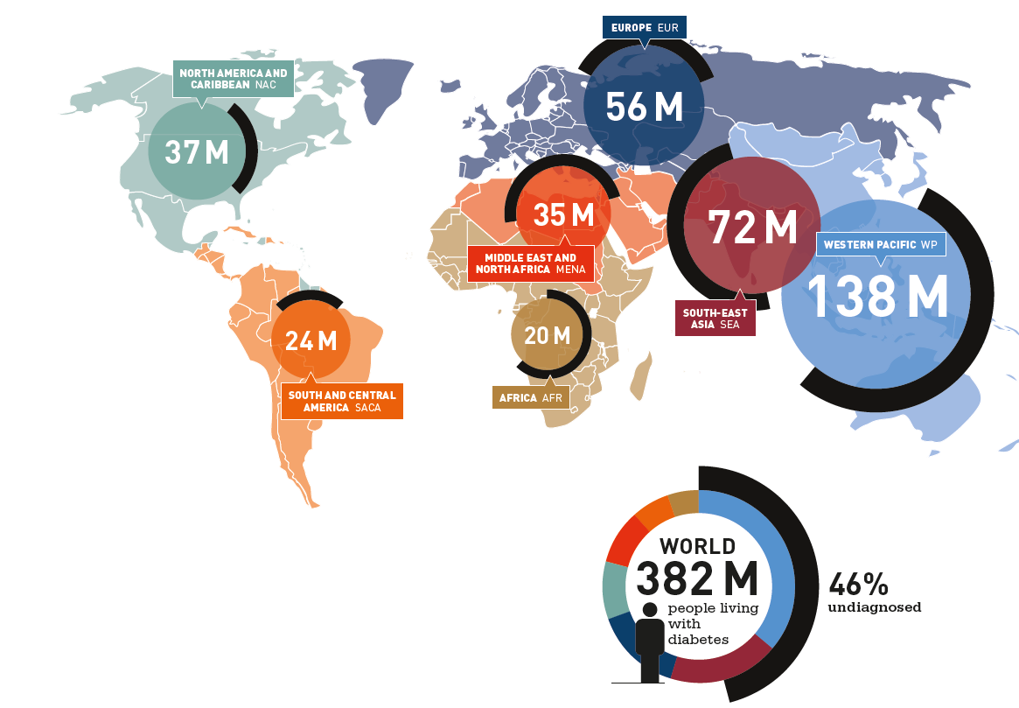

Slide 5
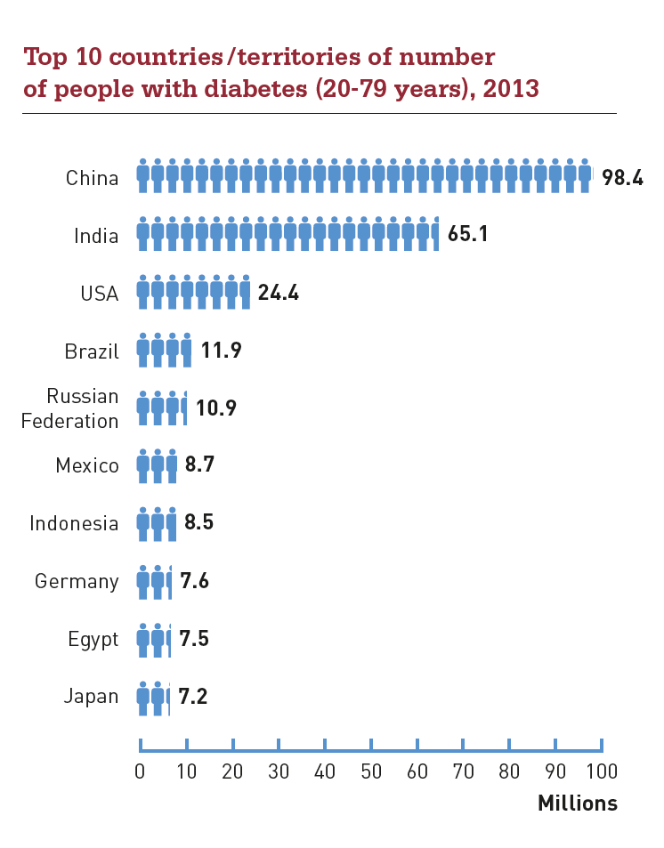

Slide 6
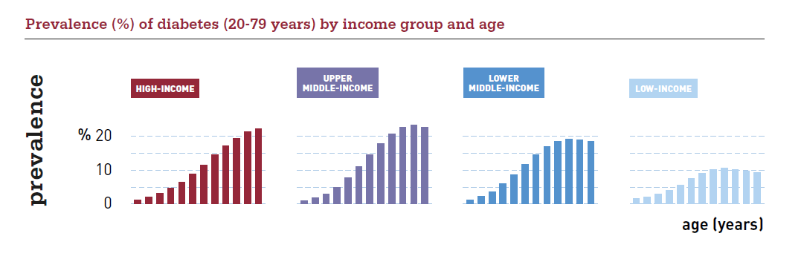
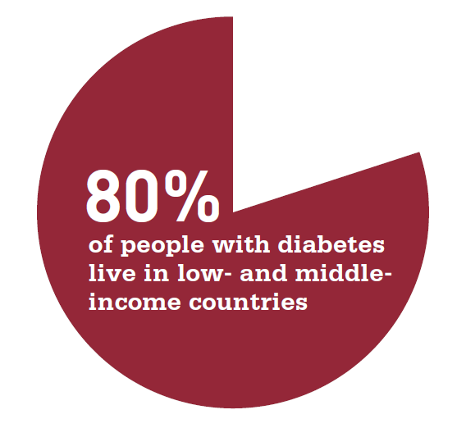

Slide 7
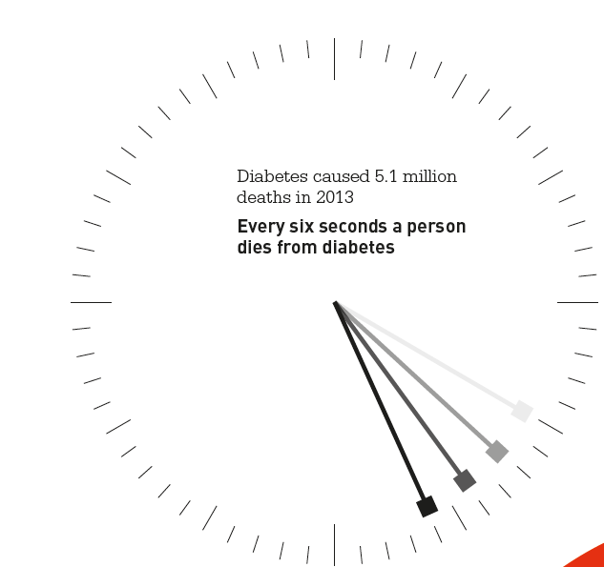
CVD
More than
5 million deaths per year
Kidney failure
Diabetes foot
Complications
Retinopathy
Arteriosclerosis
Neuropathy

Slide 8
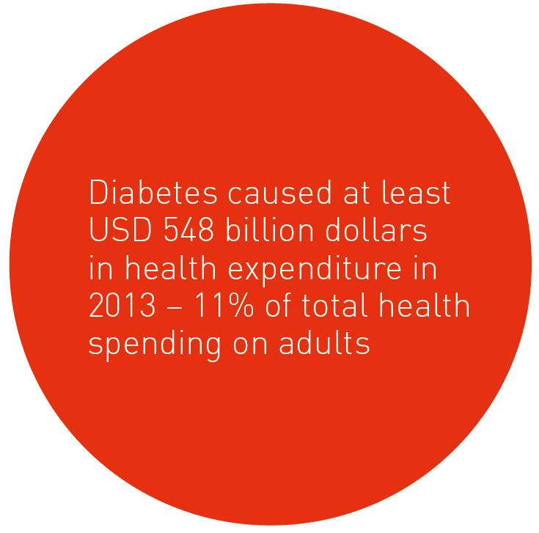

Slide 9
678 billion USD will be spent on diabetes related health care by 2035

Slide 10
In summary
382 million people with diabetes
5 million annual deaths
>10 % of healthcare cost to diabetes
Half due to complications
Prevalent in all countries

