Slide 1
Orthopedic appliances
Inlays
Shoes
Orthoses
Notes:
I am going to say something about the orthopedic appliances that we provide for this group of patients. I have divided it in three groups: Insoles, Shoes and Orthotics – other orthoses than insoles

Slide 2
Ortopediteknikk AS avd. Ryen, Oslo
Notes:
I am in the foot clinic every Monday. This is where I work the rest of the time and where we have the production.

Slide 3
Inlays – pressure distribution and pressure relief

Slide 4
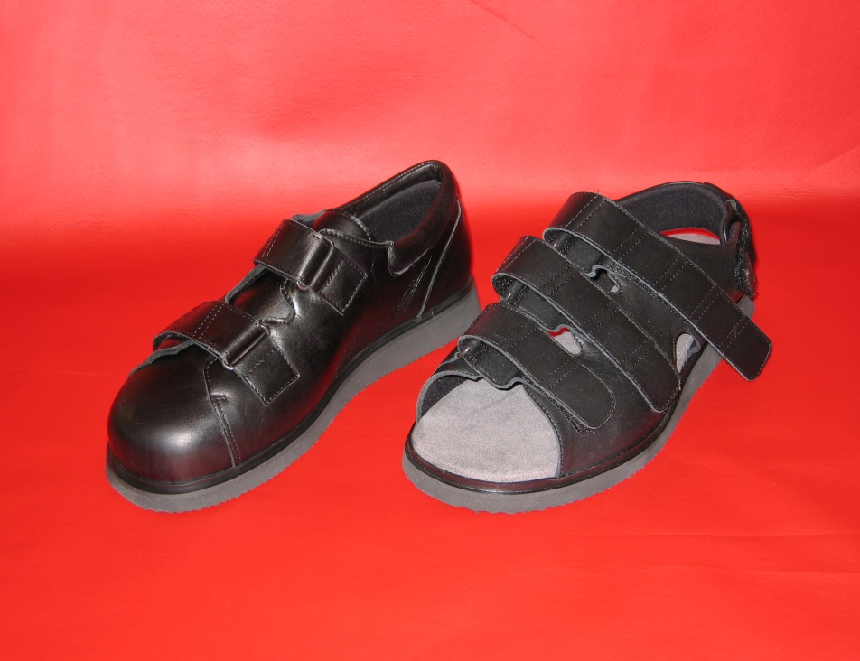
Special shoes – of the shelf combined with inlays shoes with a rigid outsole, no seams on the inside

Slide 5
Orthopedic shoes
NOF, Norsk Ortopedisk Fottøy as
Custom made shoes

Slide 6
Silicone Foot-Toe orthoses
Offloading and/or correction of toes

Slide 7
TAFO: Total offloading Ankle Foot Orthosis

Slide 8
A foot with a neuropathic foot ulcer or a Charcotfoot

Slide 9
Treatment is empirical and relies on rest and strict limitation of weight bearing, usually with total contact casting. Removable casts and walkers have also been recommended

Slide 10
It appears that a total contact cast (TCC) heals a higher proportion of neuropathic plantar ulcers at a faster rate than removable modalities such as a removable walker (RW), off-loading shoes (i.e. half-shoes) and therapeutic footwear (evidence: 1-, 1-, 1-, 2-).
It appears that a RW which is made non-removable is more effective than a RW and similarly effective as a TCC in healing diabetic neuropathic plantar foot ulcers (evidence: 1+, 1+, 1-).
A preponderance of evidence in the area suggests that a dedicated focus on adequate pressure relief is an important and likely essential component of successful, consistent and predictable healing for the majority of neuropathic diabetic foot wounds. Because of its effect on pressure reduction and adherence to therapy, we recommend consideration of the use of a TCC in treatment of neuropathic, non-infected, non-ischemic plantar diabetic foot ulcers.

Slide 11
A number of studies in healthy people have shown that making the outsole rigid and either "rockered" or "rollered" can be extremely effective in reducing plantar pressure in the forefoot 118,119. While similar results have been observed clinically in diabetic patients, definitive studies in this patient group are required before recommendations for their use can be made.
Rocker shoe: Shoe with rigid outsole designed with a sharp transition on the outsole. The shoe rocks forward in the late support phase to allow walking without extension of the metatarsophalangeal joints.
Roller shoe: Shoe with rigid outsole similar to the rocker shoe, but with a contoured outsole to provide a smother transition during walking.
van Schie C, Ulbrecht JS, Becker MB, Cavanagh PR: Design criteria for rigid rocker shoes. Foot Ankle Int 2000; 21: 833-44
Nawoczenski DA, Birke JA, Coleman WC: Effect of rocker sole design on plantar forefoot pressures. J Am Podiatr Med Assoc 1988; 78: 455-460

Slide 12
Plaster cast
Plaster negative

Slide 13
Plaster positive

Slide 14
Rectification: ulcer pressure relief + toebox

Slide 16
Construction of orthosis
Ulcer
Sandwich constructed insole
multiform – soft, easy to mould, smooth and easy to clean
Ppt – soft and pressure relieving
Microcork – firm, supports
Charcot
Insole material 40 shore

Slide 17
Soft material on the inside of the orthosis
Moulded in polypropylene – first the orthosis then the lid
Choice of colour/pattern

Slide 18
Outsole made of EVA
Roller outsole
The apex of the roller sole behind the ulcer
Rubber outer sole
Velcro straps

Slide 19
Function
Compression
Ulcer
Mecanical offloading and redistribution of pressure
Some of the load is transferred to the calf
Charcot
Prevent deformities

Slide 20
Alternative to TCC
The pasient can take the orthosis off at night
Better hygiene
Can put weight on the foot and be moderately active
Can walk with the orthosis outside, summer and winter
Compliance – never put weight on the foot without wearing the orthosis

Slide 21
Other AFOs
Neuropathy can lead to poor balance
Of the shelf orthoses
Light weight
Easier to put on and take off and easier to walk
Always made with a made to measure inlay

